Slide 1
Probability
EQ – How do I calculate probabilities of combined events using tree diagrams?

Slide 2
24
7
30
Topic: Probability
Date:
EQ – How do I calculate probabilities of combined events using tree diagrams?
Tree diagrams are another useful way of listing the sample space of two or more events. Each outcome is represented on a “branch”.
Branch probabilities are used to describe the chance of each outcome at each step.
The probability of each outcome for the experiment is obtained by multiplying the branch probabilities.
Branch probabilities will depend on whether selection is made with or without replacement.
For with replacement, probabilities do not change.
For without replacement, probabilities do change.
What is a tree diagram?

Slide 3
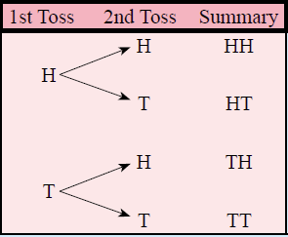
24
7
30
Topic: Probability
Date:
EQ – How do I calculate probabilities of combined events using tree diagrams?
Example – With Replacement
For a coin toss we can have a heads or a tails. What happens if we toss two coins?
What is a tree diagram?
There are four outcomes
Heads then Heads = $\frac{1}{4}=$ 0.25 = 25%
Heads then Tails = $\frac{1}{4}=$ 0.25 = 25%
Tails then Heads = $\frac{1}{4}=$ 0.25 = 25%
Tails then Tails = $\frac{1}{4}=$ 0.25 = 25%

Slide 4
24
7
30
Topic: Probability
Date:
EQ – How do I calculate probabilities of combined events using tree diagrams?
Using the same example as before:
How do I calculate the probability of combined events?
What was the probability of getting heads or tails for the first toss?
What was the probability of getting heads or tails for the second toss?
$$\frac{1}{2}$$
To find the outcome probability you multiply along the branch
P (HH) = $\frac{1}{2} × \frac{1}{2}= \frac{1}{4}$
Or as a decimal
P (HH) = 0.5 × 0.5 = 0.25
$$\frac{1}{2}$$
$$\frac{1}{2}$$
$$\frac{1}{2}$$
$$\frac{1}{2}$$
$$\frac{1}{2}$$

Slide 5
24
7
30
Topic: Tree Diagrams
Date:
EQ – How can we show two step problems with tree diagrams?
Using the same example as before:
What was the probability of getting heads or tails for the first toss?
We know these are the 4 outcomes
Heads then Heads = 0.25
Heads then Tails = 0.25
Tails then Heads = 0.25
Tails then Tails = 0.25
How do you calculate the probability from a tree diagram?
What was the probability of getting heads or tails for the second toss?
$$\frac{1}{2}$$
To find the outcome probability you multiply along the branch
P (HH) = $\frac{1}{2} × \frac{1}{2}= \frac{1}{4}$
Or as a decimal
P (HH) = 0.5 × 0.5 = 0.25
$$\frac{1}{2}$$
$$\frac{1}{2}$$
$$\frac{1}{2}$$
$$\frac{1}{2}$$
$$\frac{1}{2}$$

Slide 6
Probability
EQ – What is probability without replacement?

Slide 7
24
7
30
Topic: Probability
Date: 13/06/2018
EQ – What is probability without replacement?
In some experiments, the sample space, (list of possible outcomes) may change for the different events.
The probability for each event will be different.
Example:
There are 10 marbles in a bag. When you choose one and keep it there were 10 marbles in this first selection.
If you choose another marble and keep it, there are 9 marbles to choose from in the second selection.
What is probability without replacement?

Slide 8
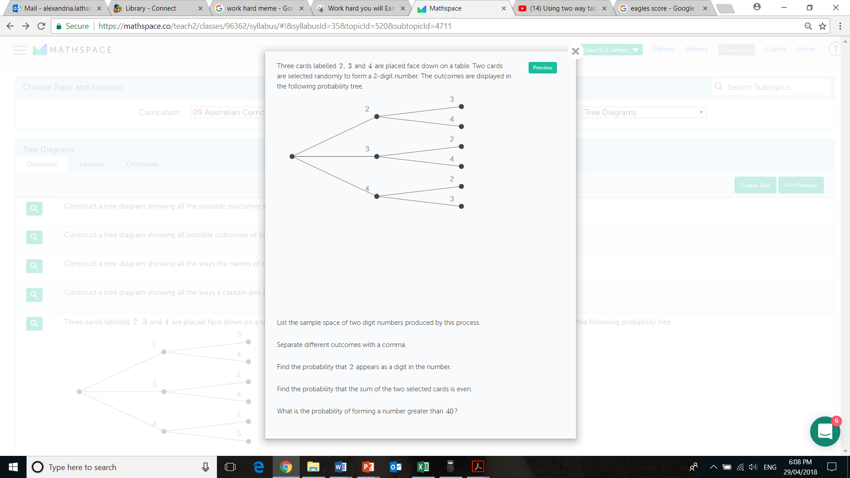
24
7
30
Topic: Probability
Date: 13/06/2018
EQ – What is probability without replacement?
Example
Since the cards are selected at the same time there is no replacement.

Slide 9







24
7
30
Topic: Two step Probability without replacement
Date: 13/06/2018
EQ – What is experimental probability without replacement?
Example
Since the cards are selected at the same time there is no replacement.

Slide 10


Slide 11
24
7
30
Topic: Probability
Date: 13/06/2018
EQ – What is probability without replacement?
How do I calculate probability without replacement?
Step 1: Draw the Probability Tree Diagram and write the probability of each branch. (Remember that the objects are not replaced)
Step 2: Look for all the available paths (or branches) of a particular outcome.
Step 3: Multiply along the branches and add vertically to find the probability of the outcome.

Slide 12
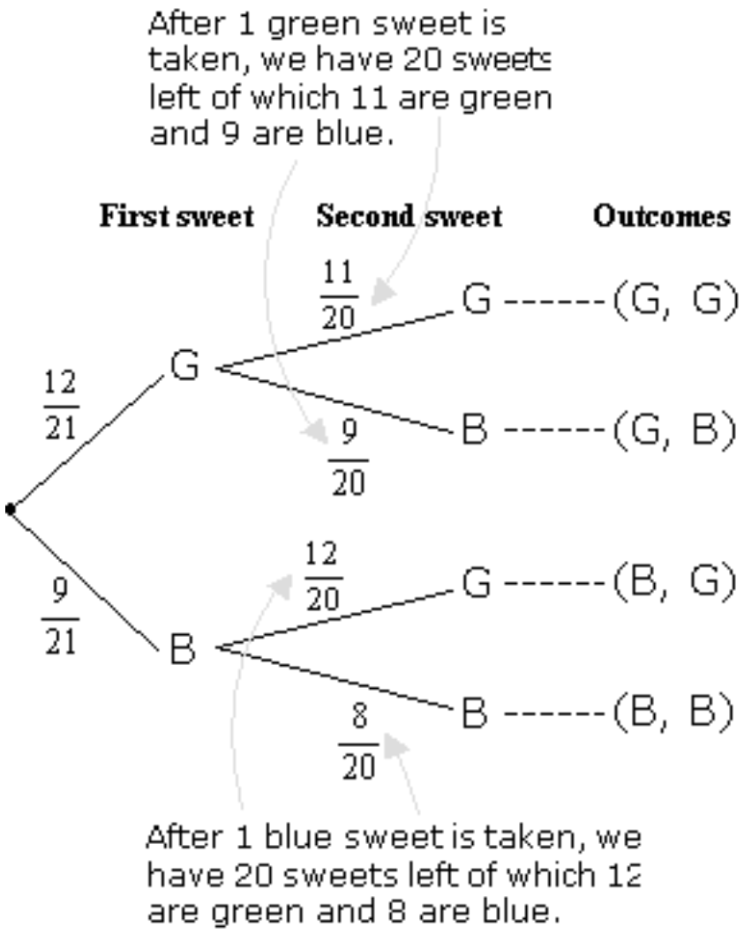
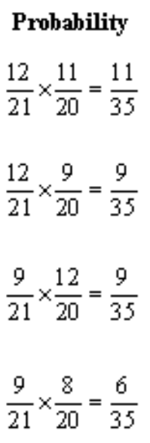
24
7
30
Topic: Probability
Date: 13/06/2018
EQ – What is probability without replacement?
A jar consists of 21 sweets. 12 are green and 9 are blue. William picked two sweets at random.
Example
a) Draw a tree diagram to represent the experiment.

Slide 13
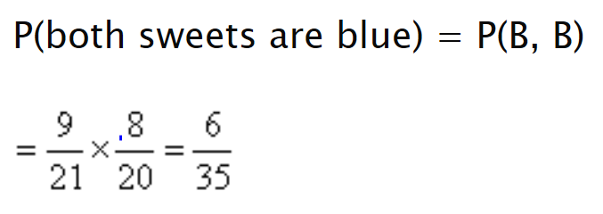
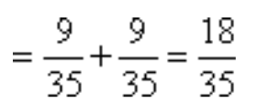
24
7
30
Topic: Probability
Date: 13/06/2018
EQ – What is probability without replacement?
A jar consists of 21 sweets. 12 are green and 9 are blue. William picked two sweets at random.
Example
a) Draw a tree diagram to represent the experiment.
b) Find the probability that i) both sweets are blue.
ii) one sweet is blue and one sweet is green.
= P(G,B) + P(B,G)

Slide 14
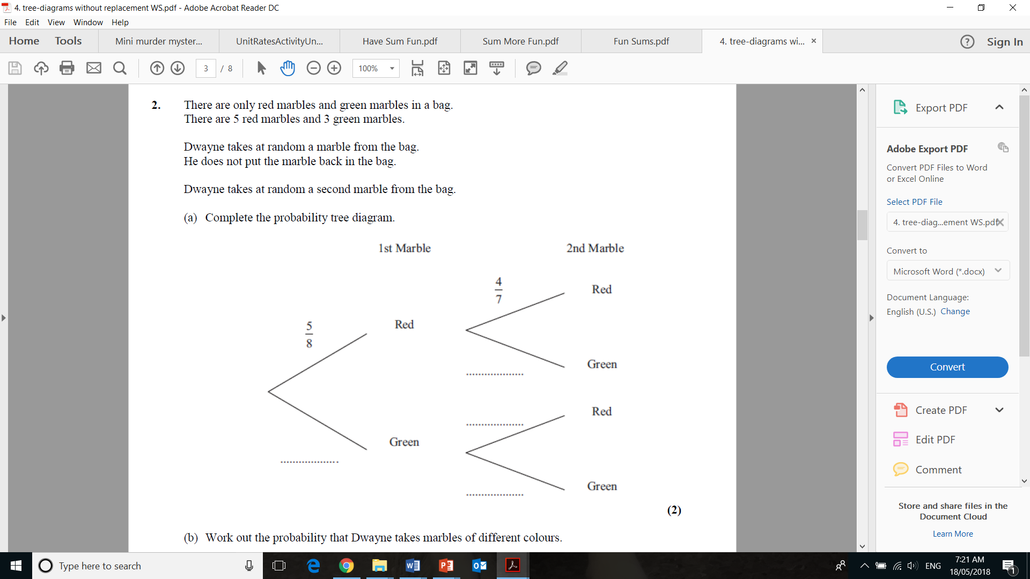
Task

Slide 15
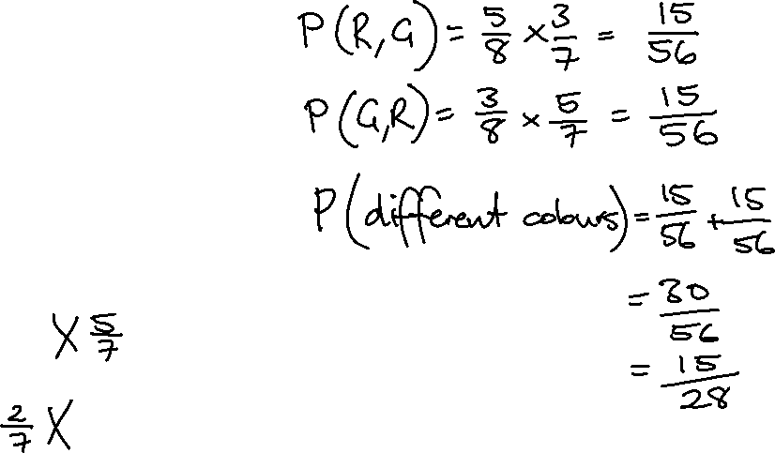
Task

Slide 16
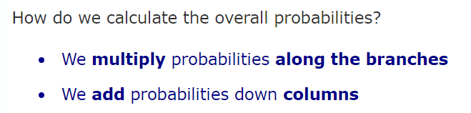
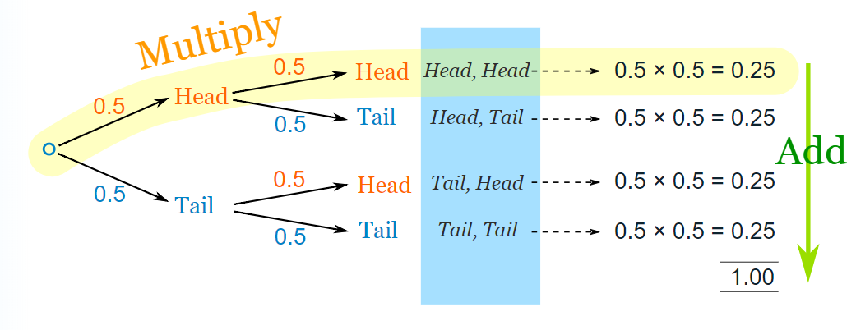
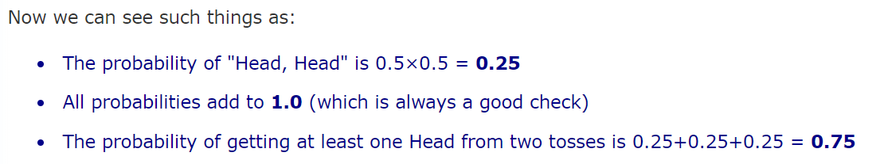
24
7
30
Date
Tree Diagrams
SUMMARY OF TREE DIAGRAMS

Slide 17
Task
MAWA TEXTBOOK
p133 Q2 and 3
p136 Q4 and 5

